Slide 1
Welcome to the 2017 AGM
From your 2017 board of directors: Fran Bates, Richard Colden, Arndt Kruger, Lisa Martin, Archie McDonald, Kate McGovern, Murray Russell, Kelly Wilson

Slide 2
5. President’s report:
Appeal for new board members
Tapping’s Bay dock survived well / No additional parking
Welcome sign with mentioning of donors, and some friendly advice for users
MPOA: The year in review:
Commercial General Liabilty Insrance plus Director &Officers Insurance
No news on Incorporation (delay of ONCA legislation)
Denbigh Ambulance service
Fish Habitat Enhancement
OPP boat washing
Hydro and Bell
Building Permit changes for docks/ floating docks
Gypsy moth traps available (inserts & pheromen: free of charge / new traps: $5.00)
Septic: 10 points about keeping your septic working well
AH: Septic tank inspection (brochures - Health Unit)
6. Treasurer’s Report (Richard Colden, Treasurer)
7. Guest Speakers:
Jill Watersheds Canada
8. Lisa Martin: Lake Steward Report
9. Fran Bates, MPOA Membership & Communications updates
* Food drive when closing cottage?
* Photo contest?10. Election to fill vacancies on the MPOA Board (Fran Bates)
Call for nominations from the floor
(Candidates should present themselves briefly and indicate what his/her interests are)
In Honour of Canada’s 150th Anniversary Trivia
July 1st was declared a statutory holiday in which year?
True or False: The CN Tower is the highest structure in the world
Where does the name Canada come from
From ‘canadienne’, the French word meaning ‘joining’
From Kanata, the Metis word meaning ‘lakes’
From Kanata, the St Lawrence Iroquoian word for village
From ‘cantata, the Inuit word for country
What year were Aboriginal Peoples granted the right to vote?
What was the original name of Ottawa, our capital of Canada?
Canada is a bilingual country, but what is the only official bilingual province?
Quebec
New Brunswick
Ontario
Nova Scotia
When did Canada’s flag become official?
How many bottles of beer is produced per minute at the Moosehead Brewery in SJ New Brunswick?
True or False: Winnie the pooh was named after a bear in Winnipeg?
Name 5 famous Canadian actors or singers
True or False: Canadians consume more Kraft dinner per capita than any other nation
What is Canada’s official sports, lacrosse or hockey?
Which is the longest river in Canada?
Which city in Canada has the biggest temperature swings in 24 hours?
Notes:
1. 1879 (to celebrate the country’s confederation, which happened in 1867
2. The CN Tower was the world’s tallest free standing structure until 2007 (building in Dubai)
3. C
4. 1950 or 1960. The Inuit were qualified to vote in 1650 in federal elections but were unable to as they lived in remote isolated communities. In 1962, ballot boxes were placed in their communities and they began to vote.
5. Bytown after Colonel John By, who headquartered there while building the Rideau Canal to connect Ottawa River with Lake Ontario
6. The only official bilingual province in Canada is New Brunswick, and Quebec is the only all-French province. Since Canada is a bilingual nation, however, each province provides its people with French schools, French courts, and French federal government services
7. Canada’s flag became official on feb 15, 1965, almost 100 years after becoming a country in 1867. There were 13 diff. flag designs before the maple leaf
8. Moosehead Brewery in Saint Joh, NB, turns out 1642 bottles of beer per minute
9. A bear cub named Winnipeg was exported from Canada to London zoo in 1915. Christopher Robin Milne loved to visit the bear and this inspired the stories written by his father A.A. Milne about Winnie-the-Pooh
10. Paul Anka, Neil Young, the Guess Who, BTO, Steppenworlf, Avril Lavigne, Rush, Bryan Adams, Barenaked Ladies
True
Both
13.Which River is the biggest in Canada-hint it flows North-----MacKenzie
14.Which city in Canada has the biggest temperature swings in 24 hours. Brandon - why because it is so far from water!!

Slide 3
2017 AGM Meeting
Agenda
President’s Report | Arndt Kruger
Treasurer’s Report | Richard Colden
Lake Stewart Report | Lisa Martin
MPOA Communications | Francine Bates
MPOA Membership Special Project: Directory | Kate McGovern
Through the Lens of History: What Has Changed since 1859 and What Has Not | Margaret Axford, Historical Society and the head of Cloyne Pioneer Museum
Call for new board members | Harry Van Ymeren
General discussion | Members
Comparison of Admin costs of townships of North Frontenac with Addington Highlands | Kip Van Kempen

Slide 4
President’s Report
Approval of 2016 minutes
Year in Review
Investigation of Firehall rumours
Tapping’s Bay boat ramp
NF Municipal Building project
Fish Habitat Enhancement 2018
Love your Lake Shoreline assessment
Gypsy moth traps
Lyme disease
New board members
Presented by Arndt Kruger, MPOA President

Slide 5
Summary of Receipts and Disbursements For the Year Ended March 31, 2017
Receipts | Memberships | 3,650
 | Gypsy Moth Traps | 175
 | Other | 80 | 3,905
Disbursements | Bank charges | 15
 | Gypsy Moth Traps | 452
 | FOCA | 687
 | Insurance | 1,150
 | Meetings and office | 168
 | Tappings Landing upgrade | 1,255
 | Website | 468 | 4,195
 |  |  | (290)
Opening bank balance |  |  | 9,980
Closing bank balance |  |  | 9,690
Unaudited - See Notice to Reader

Slide 6
Water Testing Summary
2016 water testing for invasive species – NEGATIVE
Mississippi Valley Conservation Authority changes in protocol:
Now testing Mazinaw every 2 years (vs. every five years)
Increase testing on large lakes like Mazinaw with an important role in the watershed, and decrease testing on smaller more remote lakes
Tests include phosphorus (levels down in 2016), dissolved oxygen, water temperature, secchi depth, pH, calcium, and invasive species (zebra mussels and spiny water flea)
Data available online - Integrated Monitoring Report http://mvc.on.ca/2016-integrated-monitoring-report-now-online/
Presented by Lisa Martin, MPOA Lake Stewart

Slide 7
Water Rangers – Citizen Science
Water Rangers promotes citizen science, and using an open-data website, provides an interface for people to collect water quality data www.waterrangers.ca
MPOA:
selected for water sampling initiative through Water Rangers
received a free kit (value $350) through the Ontario 150 program
have committed to 30+ sample points
Weekly samples at Bridge by Brown’s
Monthly samples near Bon Echo Park beach
Other sample locations of interest

Slide 8
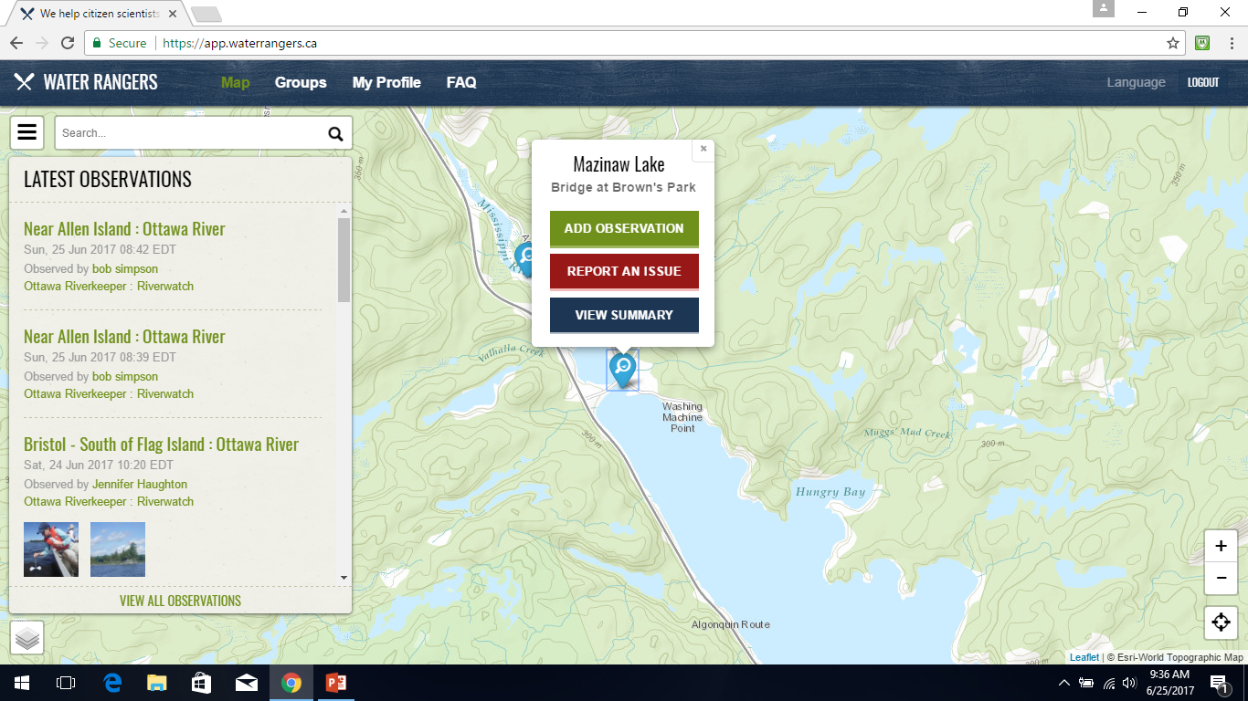

Slide 9
Water Summary
May 2017-Present

Slide 10
Mississippi Valley - Native Plants Program
Mississippi Valley Conservation Authority provided free native plants for people who signed up last year
28 properties participated, with a total of 359 plants
* Reminder – still some plants at Brown’s need to be picked up
Thanks to all who participated!

Slide 11
Communications
Two ways: email & website
Reminder:
is your email address current with us?
Initiatives & Focus Items
Lost & Found
Buy & Sell…check it out…lots for sale
Emergency preparedness
Submit interesting stories for the website
Poll for Top 3 issues
Speed reduction near Bon Echo Park / Narrows
letters to MVCA and Bon Echo Park
Dark night initiative
Pick one night and everyone turn off lights
Promote automatic solar lights
Composting at dump
Also consider secure compositing alternatives at your cottage
Id: communications@lakemazinaw.ca
Website: lakemazinaw.ca or lakemazinaw.com
Notes:
Fire ban
Write letters to MVCA and Bon Echo Park

Slide 12
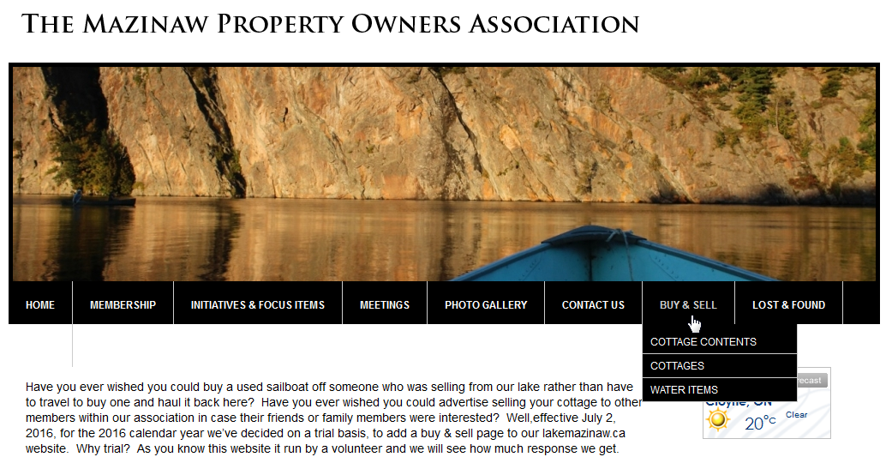
Buy & Sell:
Available to current 2016 MPOA members only at no cost
The service will be on a best efforts basis.
The MPOA will not be responsible for any articles sold/bought (e.g. the condition of, or liable for, any articles).
Items to be sold must be cottage related (cottages, water toys, boats, appliances, cottage furniture); not commercial
New submissions will be collected during the week and every attempt will be made to post new submissions each Tuesday.
After the initial submission is posted to the website, all communications will be between the buyer and the seller.
An article will be posted on the website for up to a 3 week period. A seller may ask for it to be renewed.
Once sold, the seller will be responsible to inform the MPOA within 3 days of the sale so the article can be removed from the website.
Submit an article to sell by preparing short write-up of the article, and your contact information and send it to communications@lakemazinaw.ca with no more than 1

Slide 13
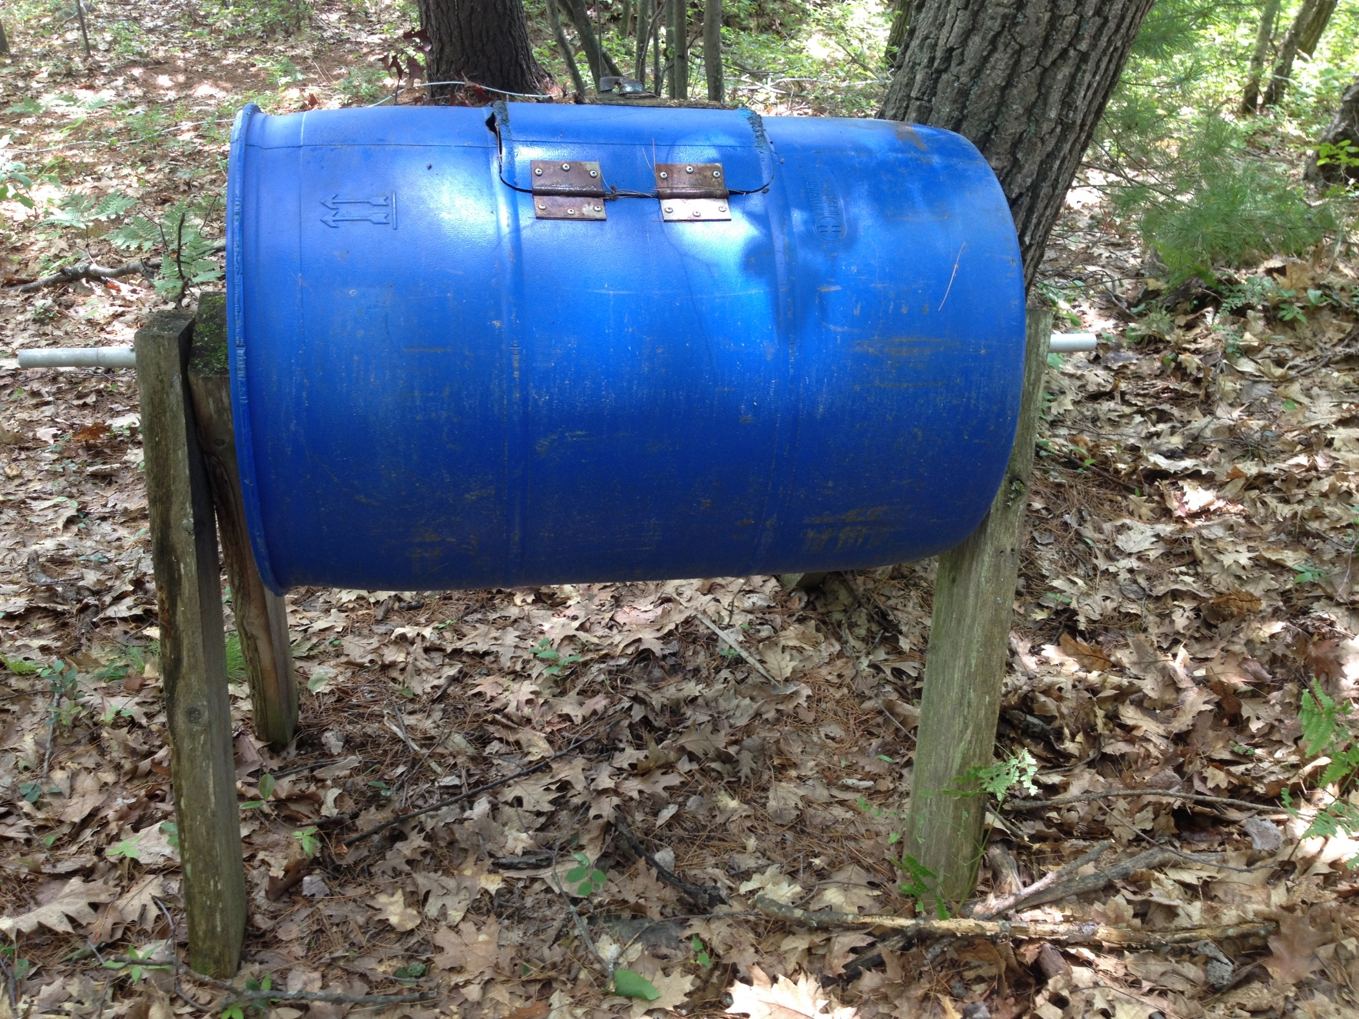
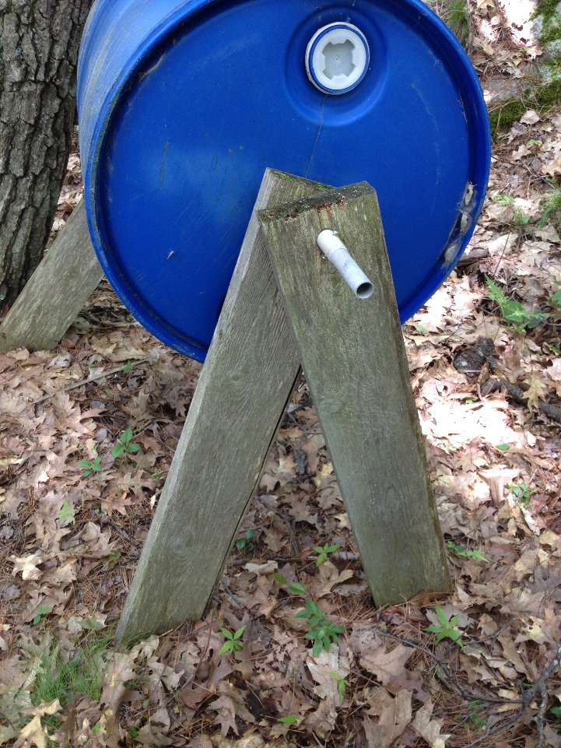
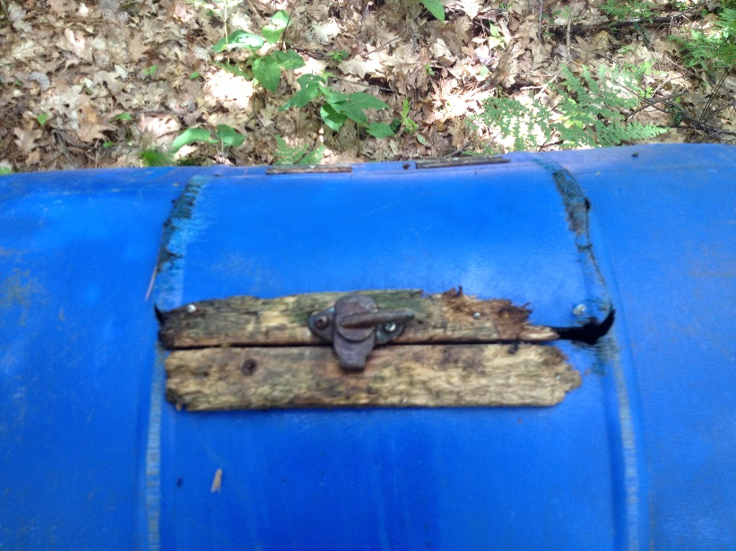

Slide 14
Communications
Mazinaw Property Owners’ Association By Laws
Mandate:
This association shall be known as the Mazinaw Property Owners’ Association (MPOA). The MPOA is an unincorporated association of individuals formed to maintain and improve the quality of life and environment of the Mazinaw Lake community. The MPOA shall be carried on without purpose of (financial) gain for its members: any profits or gains to the organization shall be used in promoting its objectives.
Objective
The purpose of the MPOA shall be to unite property owners for the purpose of dealing with members, governments, organizations and agencies relative to the quality of life and environment of the community.
As a board, we’ve agreed
We will act when in the best interest of all members
We will not divide our members when there are two or more sides/opinions on a topic. In this case, we can inform only.
Presented by Fran Bates, MPOA Director , Communication
Notes:
Our membership is uniquely divided by two townships and not everything affects both; also divided by cottagers and permanent home owners and interest can sometimes be different, etc.

Slide 15
Membership
2016 – 176 members
Special Project
MPOA Directory
2017 – collect contact information
We will use existing contact information on file but canvass non-members
Looking for volunteers per bay/street to help collect information
2018 – distribute directory
Last directory: 2013
Presented by Kate McGovern, MPOA Director, Membership

Slide 16
History of the Area
In honour of our 150th birthday - Margaret Axford
Historical Society and head of Cloyne Pioneer Museum
Guest Speaker Margaret Axford

Slide 17
Call for new board members
Roles | Incumbent | Years on Board | Duties
President | Arndt Kruger | 6 | Liase with township & community groups; membership & MPOA board on issues & initiatives
Vice President | Harry Van Ymeren | 1 | Works with / back up president
Treasurer |  |  | Tracking & maintaining financial posture of MPOA
Secretary |  |  | Recording and keeping of MPOA meeting minutes *word an asset
FOCA Representative | Murray Russell | 26 | Keeps up-to-date with FOCA initiatives; rep to FOCA
Lake Stewart |  | 2 | Water quality focus incl communicate with organizations related to water quality, coordinate and partake in efforts to improve water conditions, habitat, and native species.
Memberships | Kate McGovern | 1 | Strategies to boost membership & alternatives for payments; tracking payments *excel skills an asset
Communications | Francine Bates | 6 | Monitors the communications@lakemazinaw.ca id and responds to members, community requests; Webmaster for lakemazinaw.ca; Sends newsletters to members; Updates home page with news; Updates Lost & Found / Buy & Sell; Maintains email listing & password resets *technical skills required
Community Contact | Kelly Wilson | 2 | Monitors local papers for items that might concern our membership
Director | Archie MacDonald | 2 | Provides input on issues
Special project (Directory) | Kate McGovern | 1 | Maintains/updates directory files and map changes *excel, powerpoint, word skills an asset

Slide 18
THANKS FOR ATTENDING
HAPPY CANADA DAY WEEKEND

